Slide 1
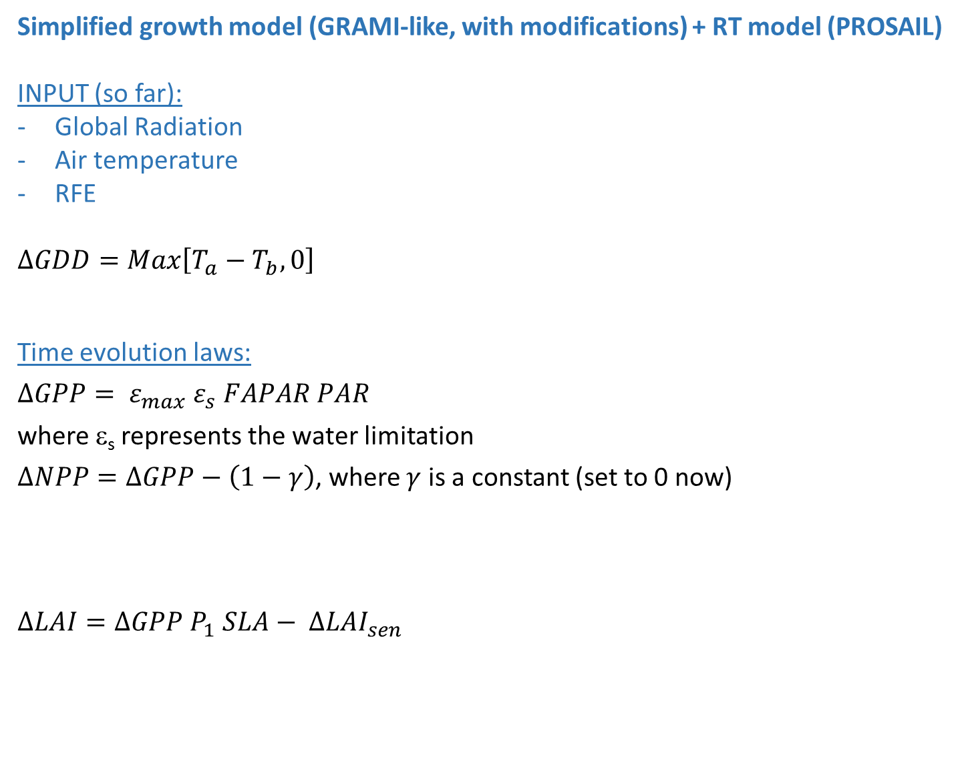
Simplified growth model (GRAMI-like, with modifications) + RT model (PROSAIL)
INPUT (so far):
Global Radiation
Air temperature
RFE
$$∆GDD=Max\left[T_{a}−T_{b},0\right]$$
Time evolution laws:
$$∆GPP= ε_{max} ε_{s} FAPAR PAR$$
where ε_{s} represents the water limitation
$∆NPP=∆GPP−\left(1−γ\right)$, where $γ$ is a constant (set to 0 now)
$$∆LAI=∆GPP P_{1} SLA− {∆LAI}_{sen}$$
OUTPUT (among others):
GPP
TOC ref in 400- 2500 nm range of any sensor (MODIS)
Contact: michele.meroni@jrc.ec.europa.eu

Slide 2

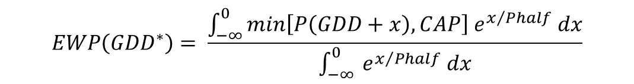
Water limitation
To avoid a full water balance modelling the following simplification is proposed:
Water availability at given time t* and GDD* is given by the weighted average of the precipitation experienced so far (effect of growing vegetation demanding more water is neglected).
Past precipitation events are Weighted with an Exponential decay so that the closest precipitations are more relevant (Phalf controls the steepness of the decay, it's the time (expressed in GDD units) in which the weights fall to one half. Using GDD makes days closer when they are hotter (when it’s hot it must rain more to achieve the same).
Precipitations are also capped to take into account that excess precipitation is not retained in the soil. The capping threshold CAP has to be determined or fixed. GDD is used instead of time on the X-axis do that the x distance in between days increases proportionally to the temperature experienced.
OWP is an optimal weighted average precipitation to be determined in inversion against eddy data.
$$EWP\left({GDD}^{∗}\right)= \frac{\int_{−∞}^{0}{min\left[P\left(GDD+x\right), CAP\right] e^{x/{Phalf}} dx}}{\int_{−∞}^{0}{ e^{x/{Phalf}} dx}}$$
$$ε_{s}= \frac{EWP}{OWP}$$

Slide 3
EWP is the mean precipitation per GDD (weighted). Phalf cannot be too long as I want to get the high frequencies in GPP modulation (the slow effect will go in reducing LAI, and thus NDVI, and thus senescensce)
Does it make sense to compare it with ExpWeighted potential evapotranspiration?
A plant would be in stress if “recent” precipitation does not meet “recent” evapotraspiration demands.
In ECMWF I have Penman-Montaith equation that is the potential evapotranspiration ET0

Slide 4
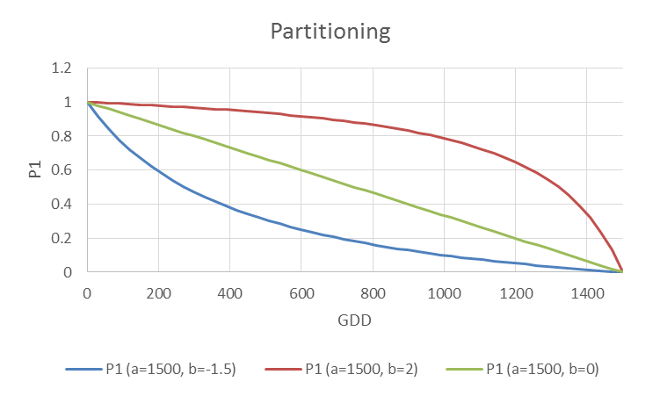
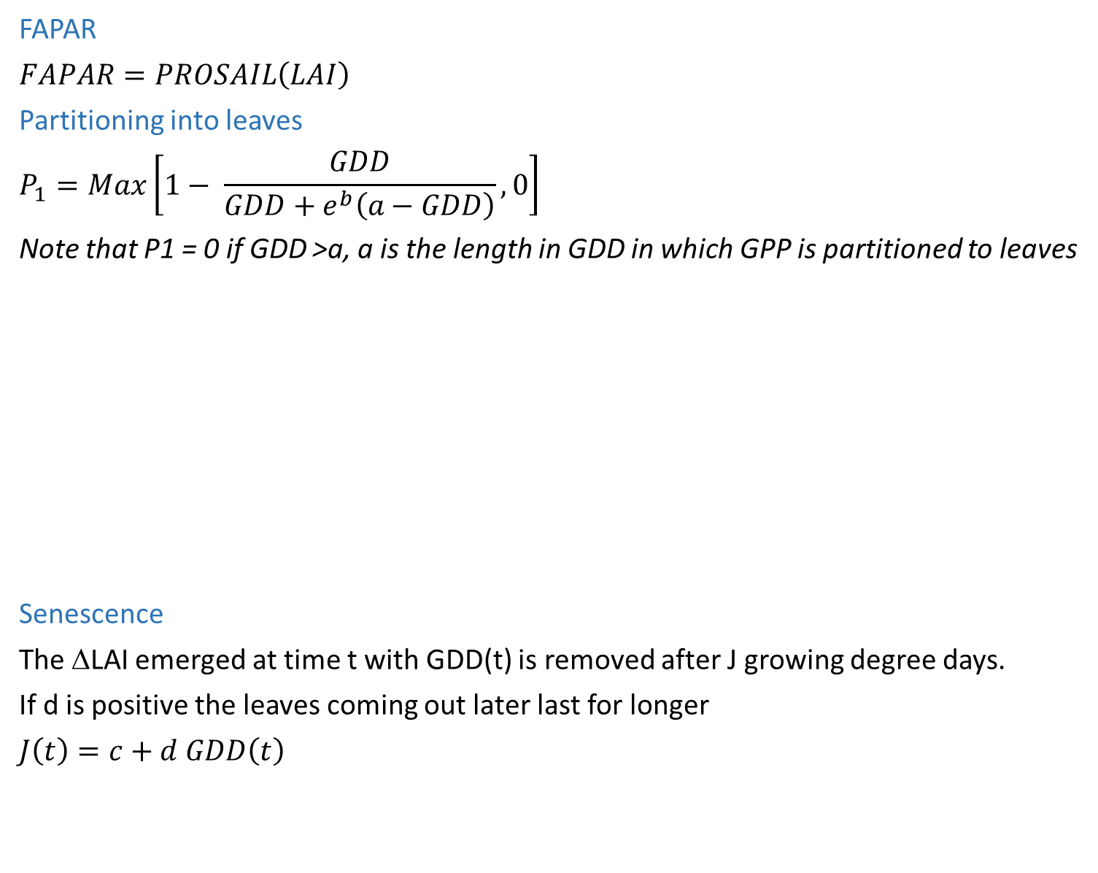
FAPAR
$$FAPAR=PROSAIL\left(LAI\right)$$
Partitioning into leaves
$$P_{1}=Max\left[1− \frac{GDD}{GDD+e^{b}\left(a−GDD\right)}, 0\right]$$
Note that P1 = 0 if GDD >a, a is the length in GDD in which GPP is partitioned to leaves
Senescence
The ΔLAI emerged at time t with GDD(t) is removed after J growing degree days.
If d is positive the leaves coming out later last for longer
$$J\left(t\right)=c+d GDD\left(t\right)$$
Contact: michele.meroni@jrc.ec.europa.eu

Slide 5
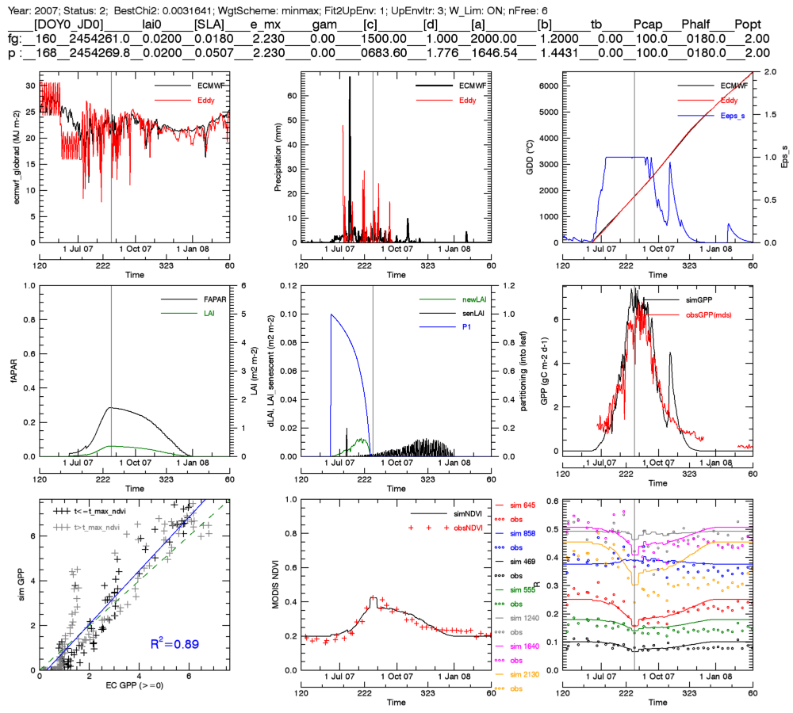
Year 2007
Met = ECMWF

Slide 6
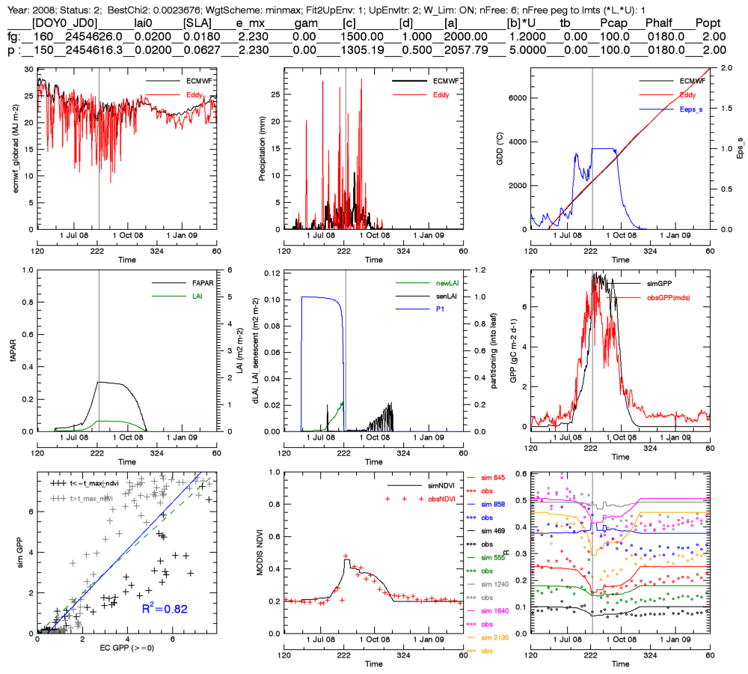
Year 2008
Met = ECMWF

Slide 7
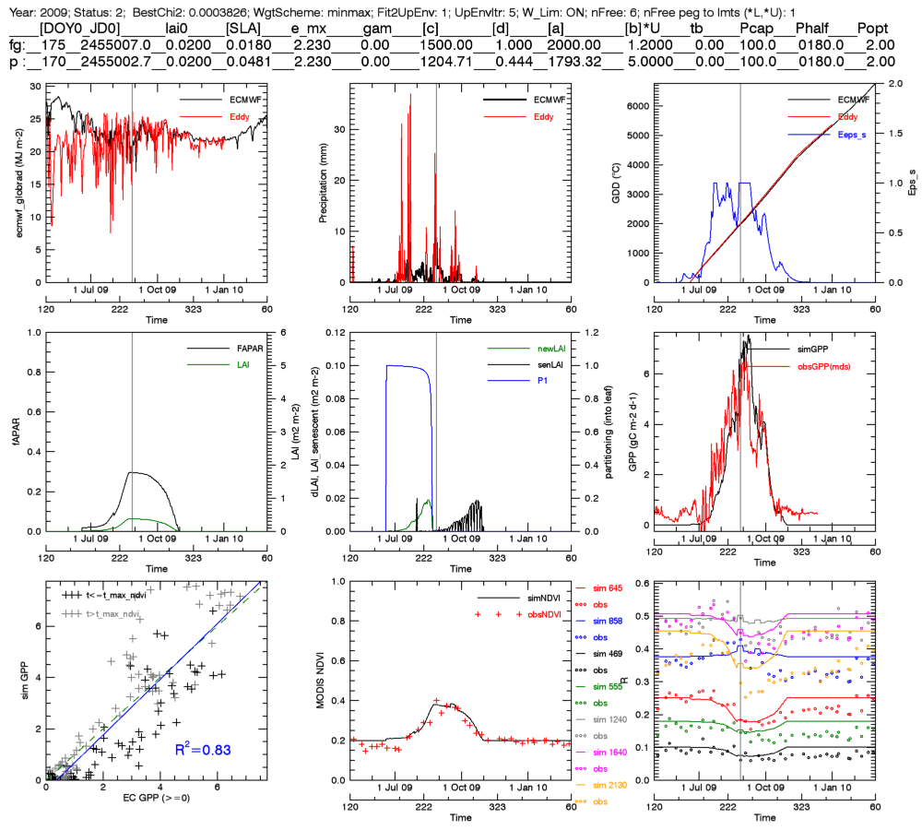
Year 2009
Met = ECMWF

Slide 8
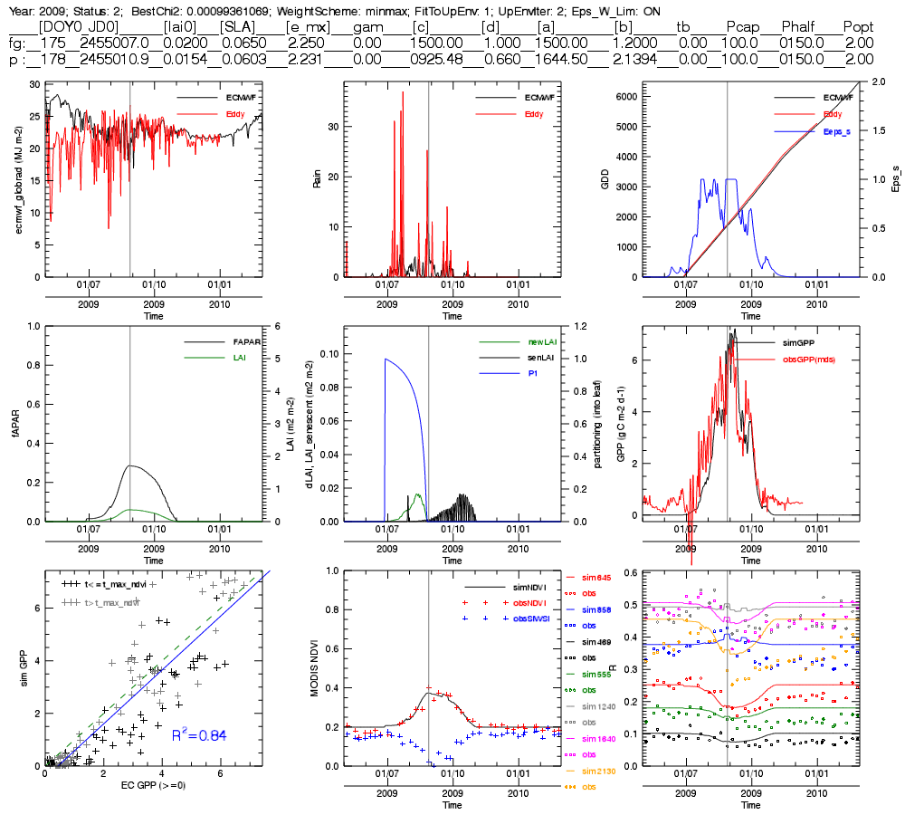
Year old 2009

Slide 9
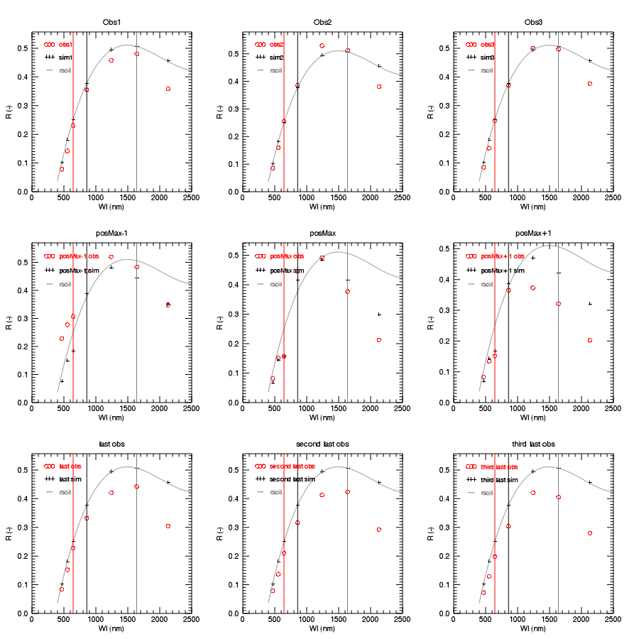
Year 2008, spectral signatures
Lower than “bare soil”

Slide 10
Contac of EC data: Jonas Ardö
EC data provided: EC for 2007-2009
Data needs:
LAI measurements
[Jonas:] No LAI2000 or similar field measurements available. MODIS LAI or perhaps
use the data in the field site description
Pictures along the season
[Jonas:] Pictures uploaded using sprend.com (see email)
Field spectra (400-2500 nm), including spectra of bare soil
[Jonas:] Not available, may be collected later.
Open issues:
Some very daily low tower GlobRad, is it realistic?
[Jonas:] See next slide
explanation for GPP drops in 2008-2009 after max GPP
[Jonas:] Grass browning, low amounts of available water?
GPP>0 out of the main season, what is there?
[Jonas]: Presence of trees possibly having access to water deeper soil
why NIR and SWIR (and RED to some extent) does not go back to pre-season in 2008-2009?
Is it likely that dry vegetation stays there (I am removing LAI to simulate senescence..)?
[Jonas:] The site around the flux tower is not grazed very much as this is a protected
(but not fenced) area. This means that there could be a lot of standing dead biomass during
the dry season.
Is there any disturbance that can happen @EOS (fires, others)?
[Jonas]: No… well there was fire once in the area (forgot which year it was)
Very low LAI (max about 0.45) and fapar (0.33) from my inversion, reasonable?
[Jonas]: No, max LAI should be around 1

Slide 11
Global radiation vs in coming PAR 2009 (Daily sums)

